Slide 1
Uber Data Analytics
Data Engineering & Analytics Project – Part 2
Performing ETL operation

Slide 2
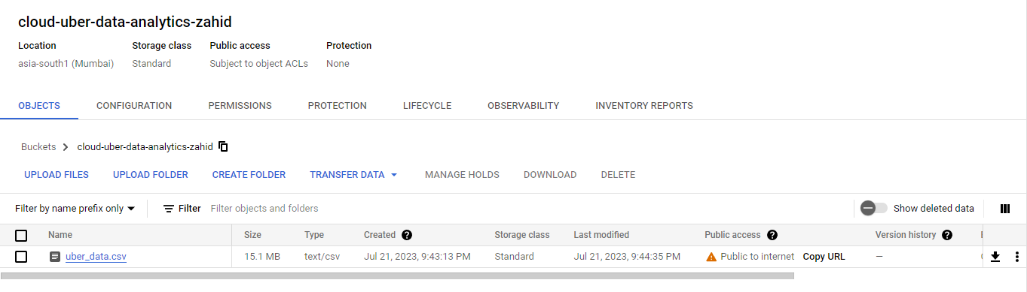
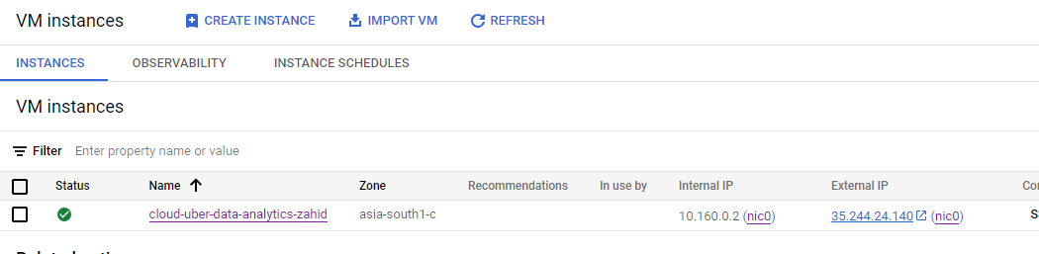
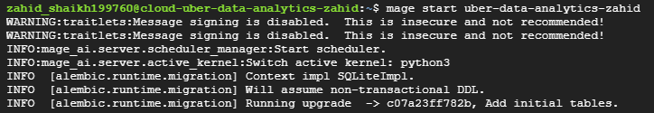
I opened a secure shell (SSH) connection and ran the mage start command to launch Mage AI on a new browser tab.
I opened a secure shell (SSH) connection and ran the mage start command to launch Mage AI on a new browser tab.
I opened a secure shell (SSH) connection and ran the mage start command to launch Mage AI on a new browser tab.
I opened a secure shell (SSH) connection and ran the mage start command to launch Mage AI on a new browser tab.
After writing the Python code, I uploaded the dataset to Google Cloud and created a virtual machine (VM) instance.
I opened a secure shell (SSH) connection and ran the mage start command to launch Mage AI on a new browser tab.
I opened a secure shell (SSH) connection and ran the mage start command to launch Mage AI on a new browser tab.

Slide 3
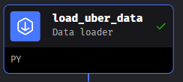
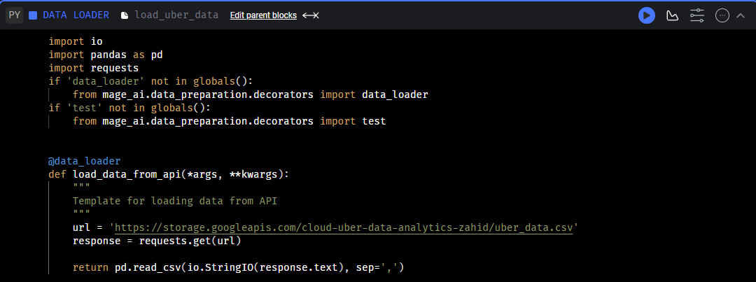
I extracted the data (CSV file) from Google Cloud and loaded it into Mage AI using the Data Loader.

Slide 4
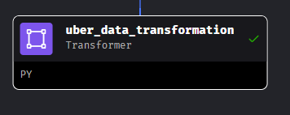
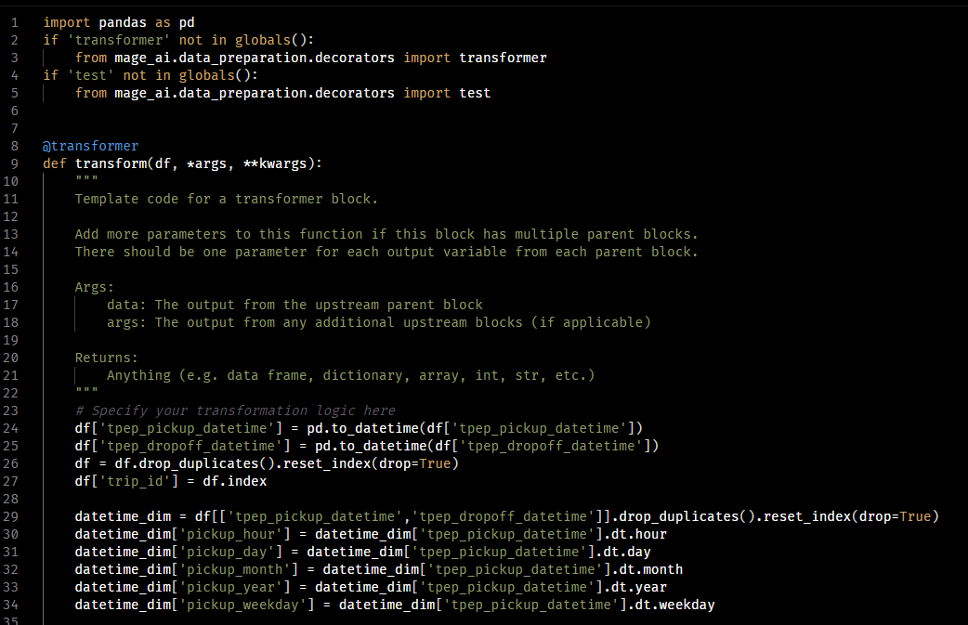
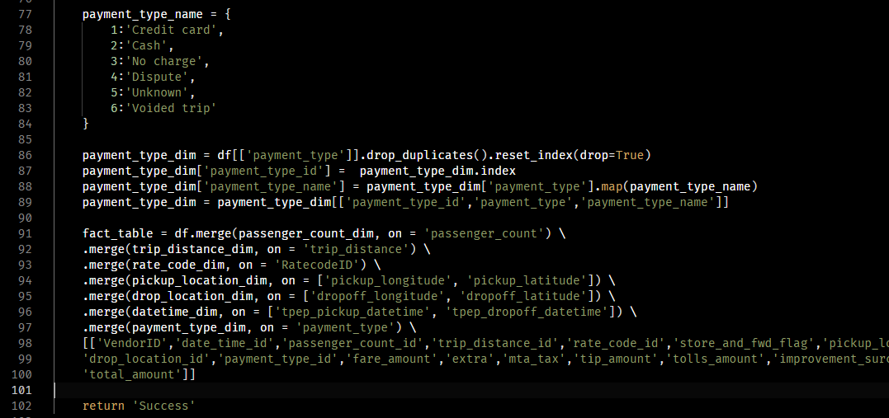
I transformed the data using the same code that I used in pandas (you can find it in project part 1).

Slide 5
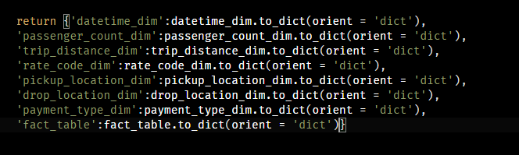
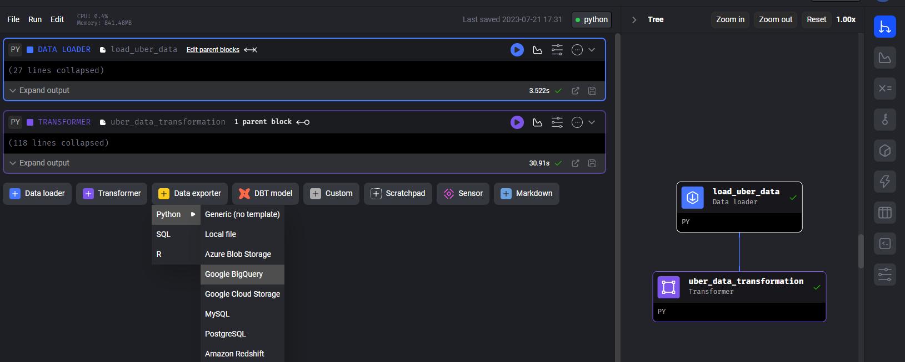
I converted the data into a dictionary (JSON file) format.
And used the Data exported option to start exporting Data to BigQuery

Slide 6
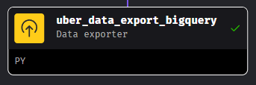
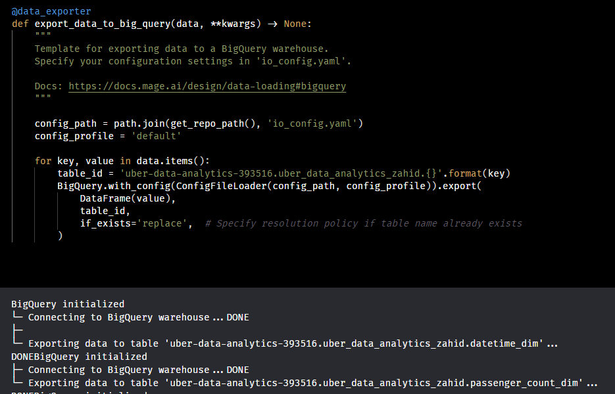
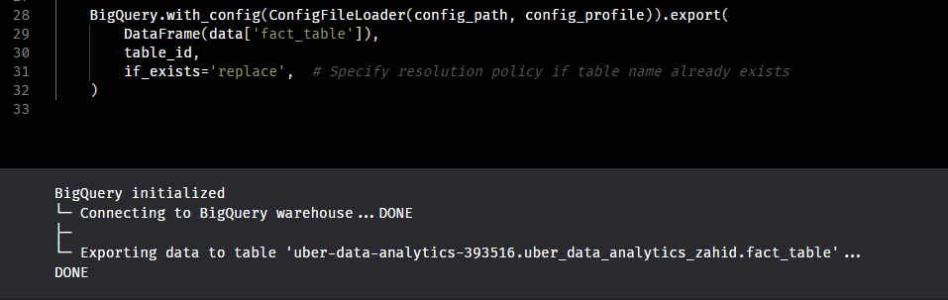
To load the data from Mage AI to BigQuery, I first exported the fact table to the BigQuery warehouse using the export option on Mage AI.
Then I wrote a code to export the dimension tables to the BigQuery warehouse as well.

Slide 7
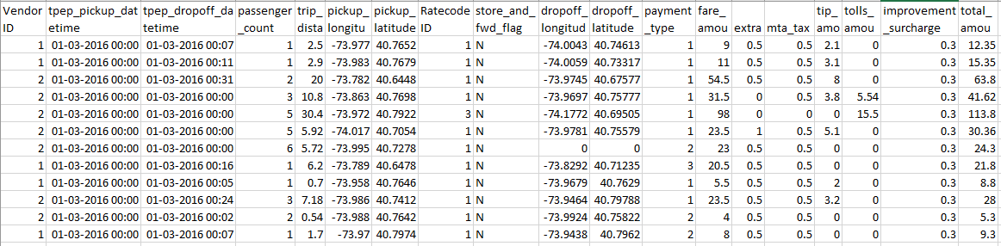
I started the project with this flat file data

Slide 8
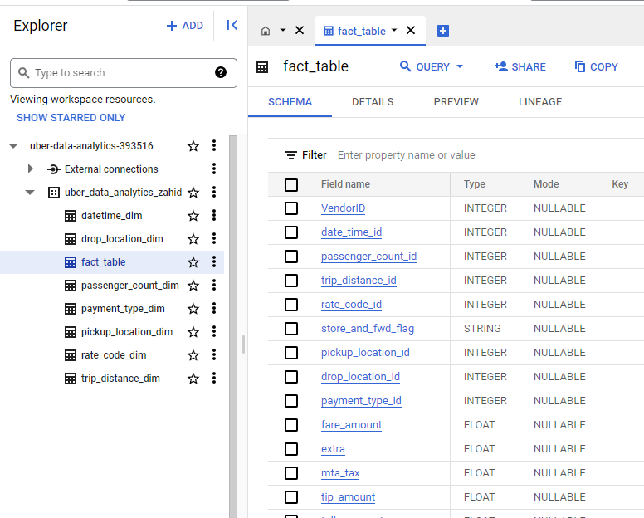
And this is how it looks in BigQuery post dimension modeling & ETL operations

